Slide 1
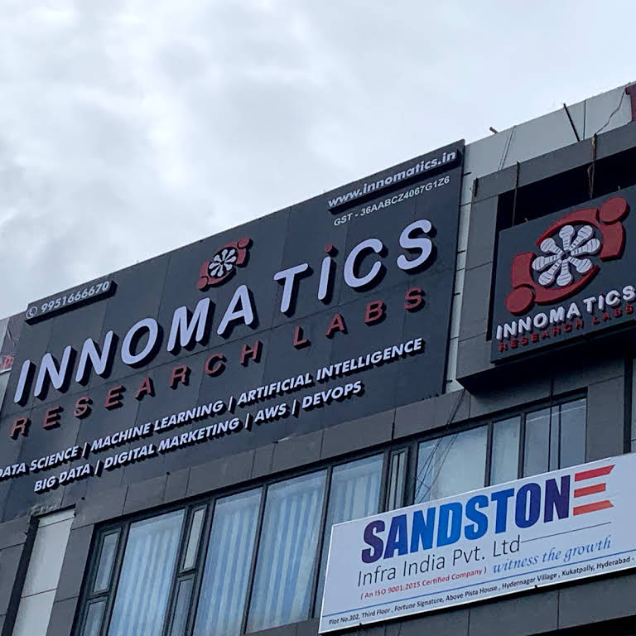
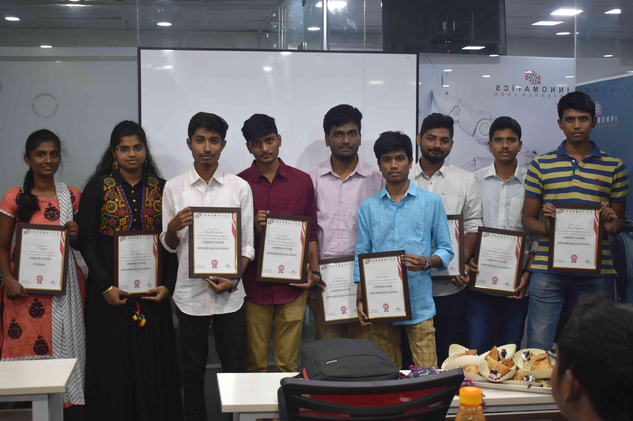
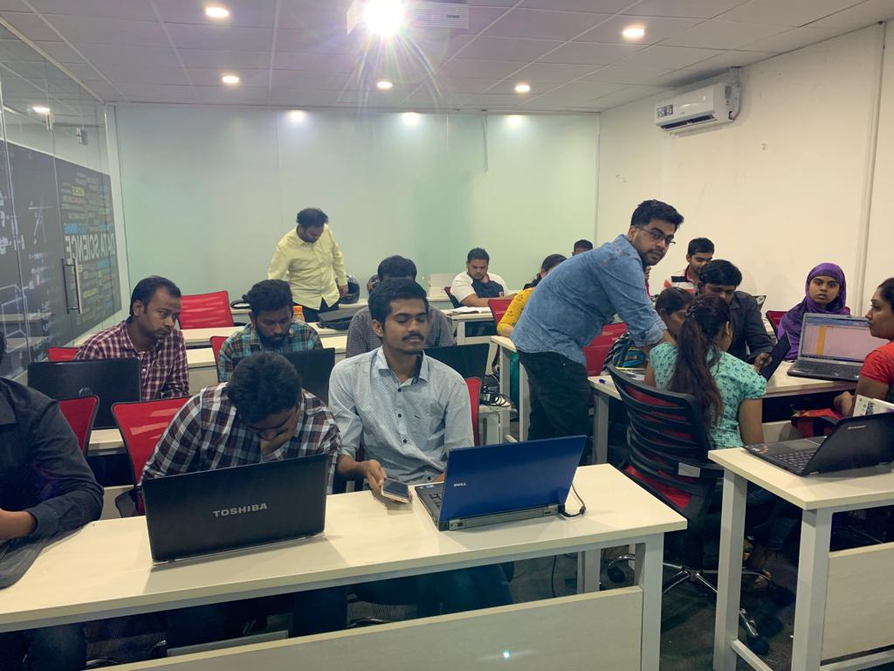

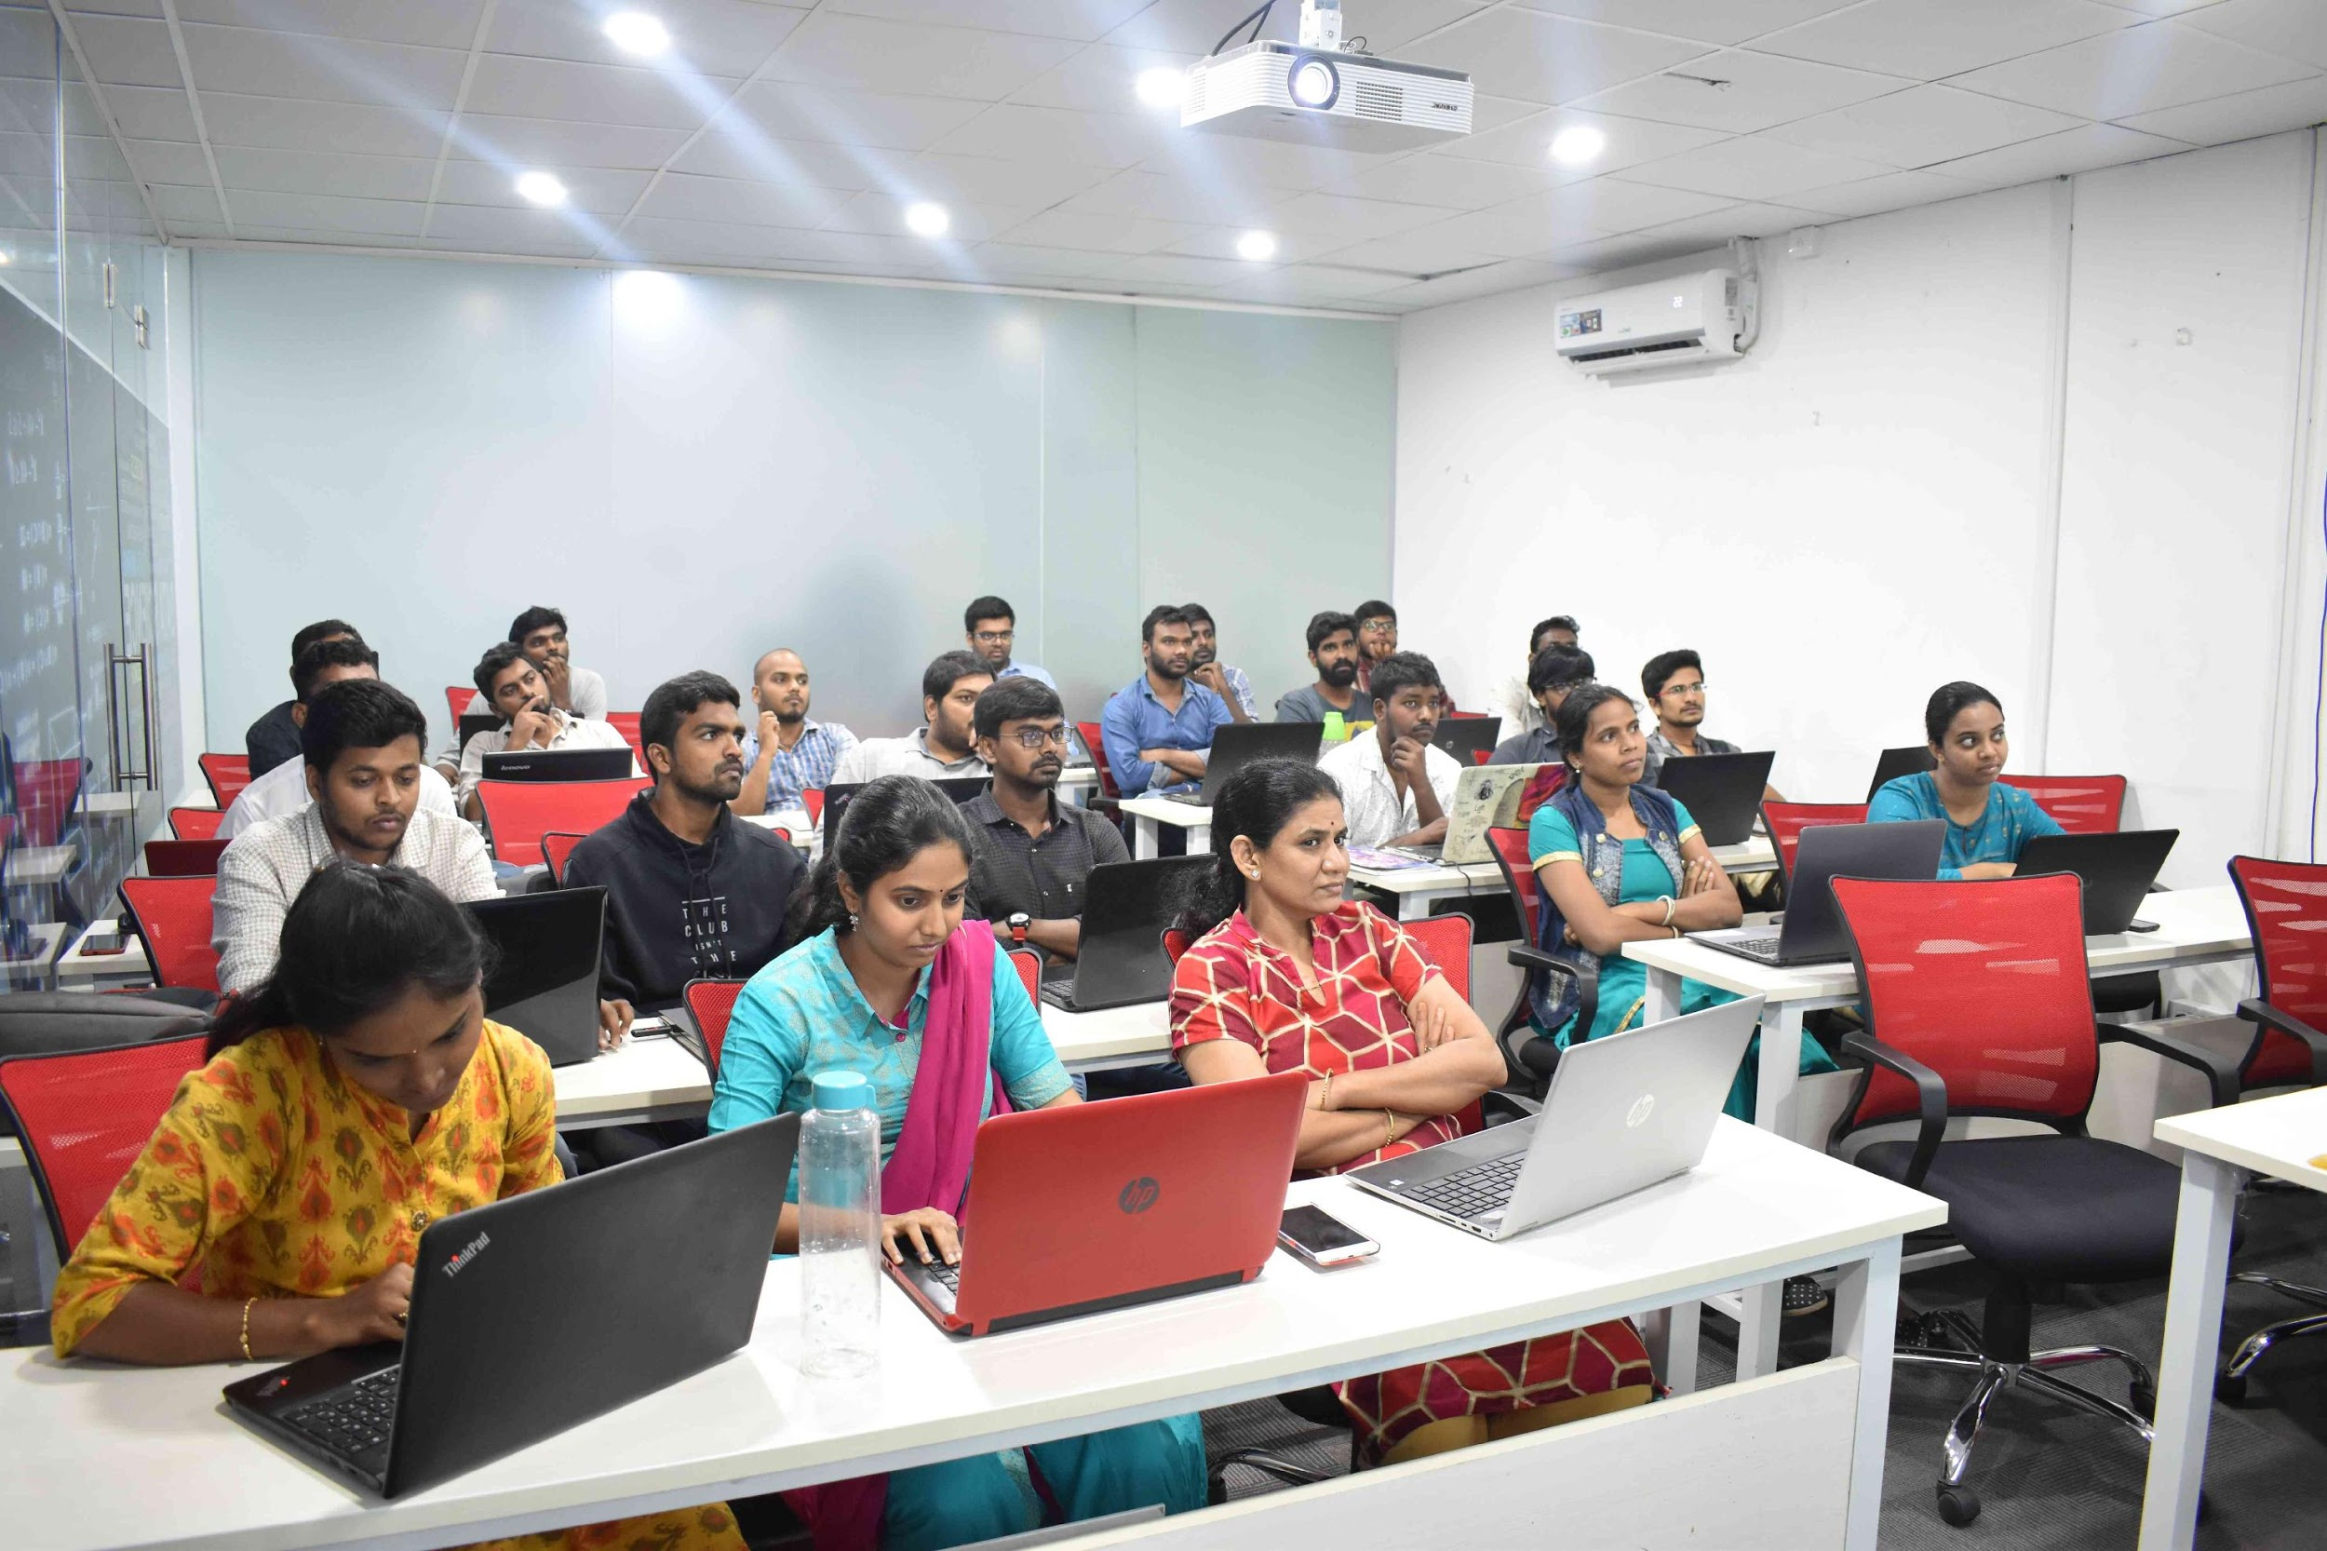
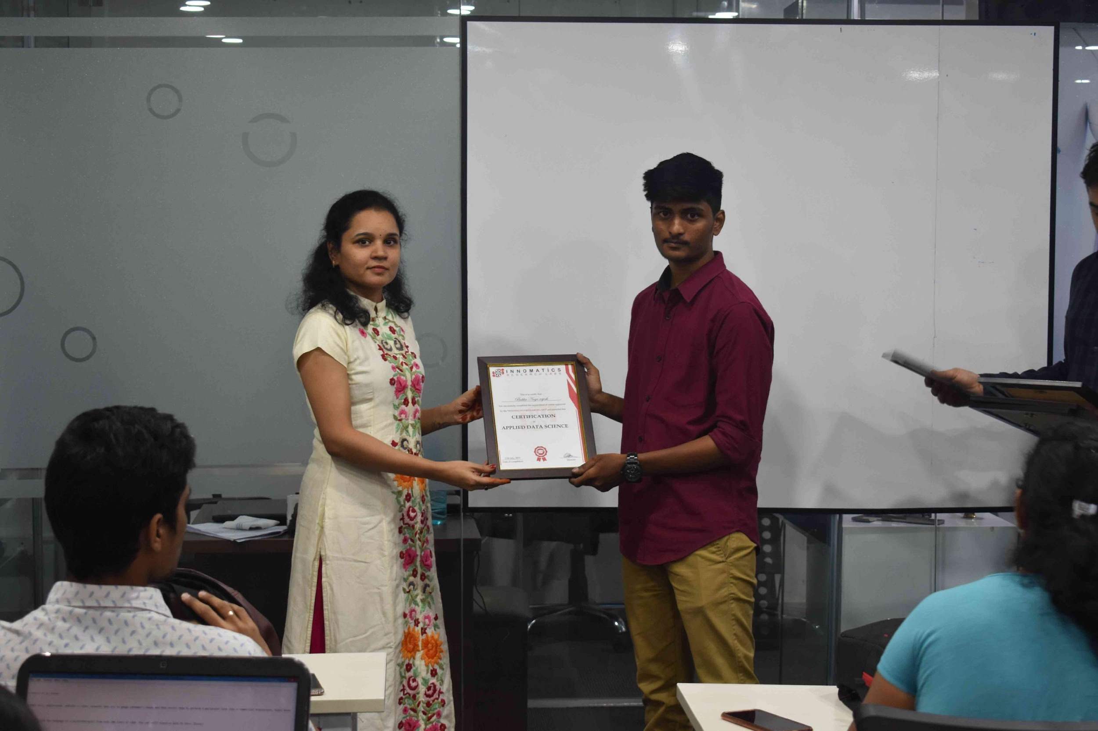
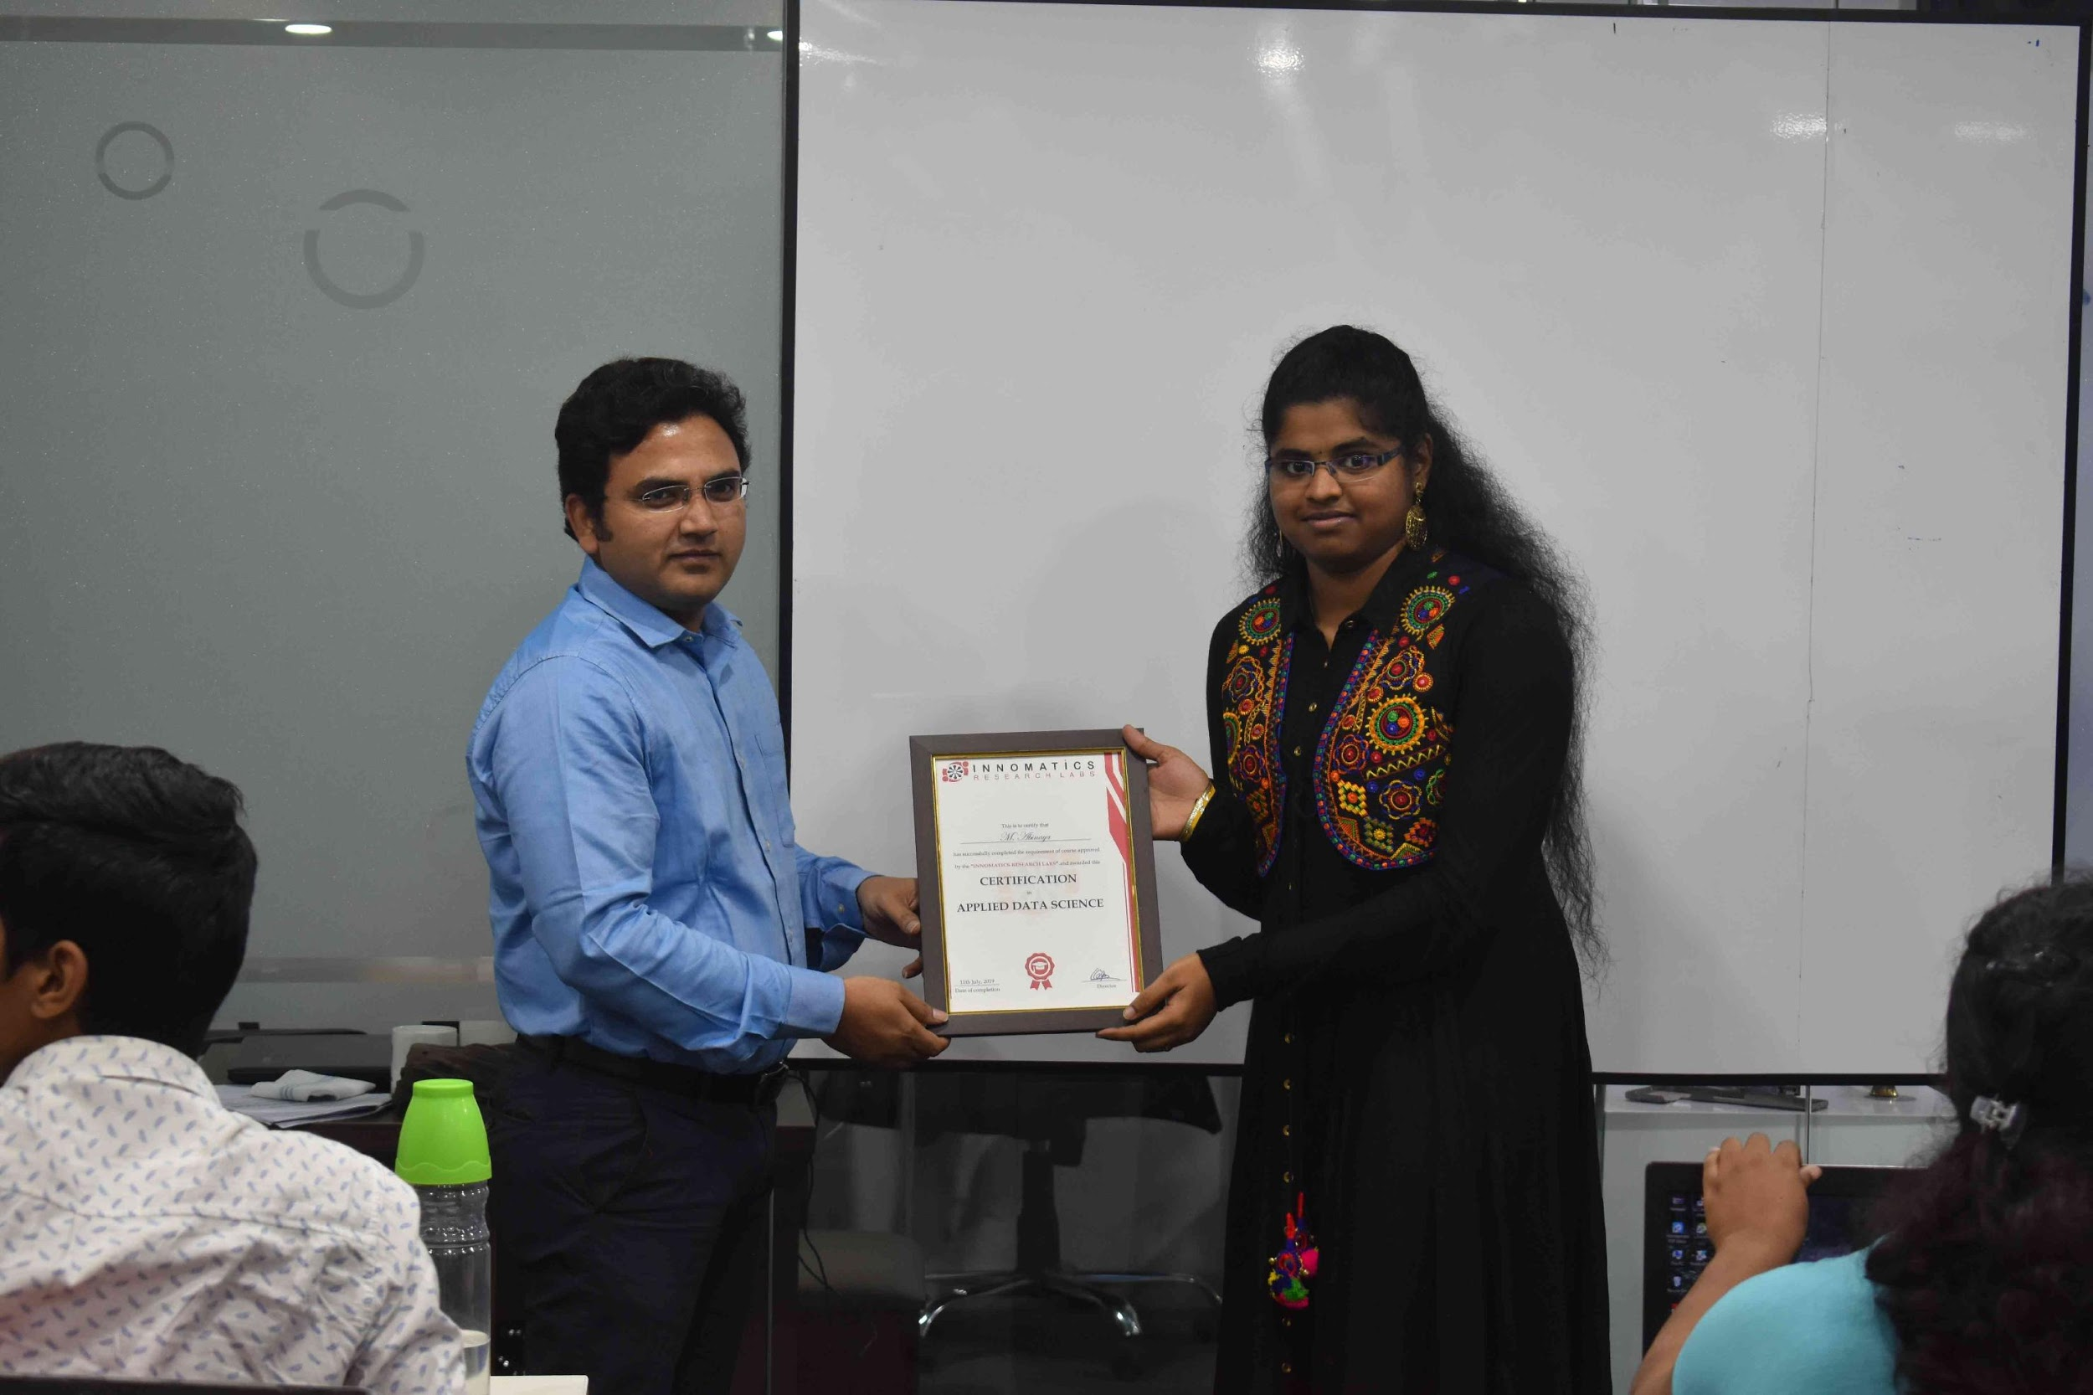

Slide 2

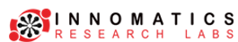
About me
Name : Abdul Majeed
Background: B.Tech-(Mech), MBA
Why you want to learn data science: one of most emerging job specially after pandemics
Any work experience : Yes, have experience In Mechanical engineering related field
What do you like about innomatics: one of the most organized institution for DATA Science

Slide 3
About me
Name : Jonnada Sai Rahul
Background : B.Tech (CSE)
Why you want to learn Data Science :
Having skills in math, statistics and in Python programming, having future scope, apart from that I am Very much interested to enter the world of Data science which not only builds my career but also helps me to achieve job in my dream company
Any work experience:
Worked as Data Science Intern at The Spark Foundation (1 Month)
Worked as Data Analysis Intern at Technocolab Software Pvt.Ltd. (1 Month)
What you like about Innomatics Research lab :
In Innomatics the topics are clearly explained from scratch in an easily grasping method by which the concept are becoming very easy to understand and able to apply in assignments & projects. All the credit goes to “Kanav Bansal Sir”

Slide 4

URL Shortener Web Application (Basic)
Flask Project - Intermediate Implementation

Slide 5
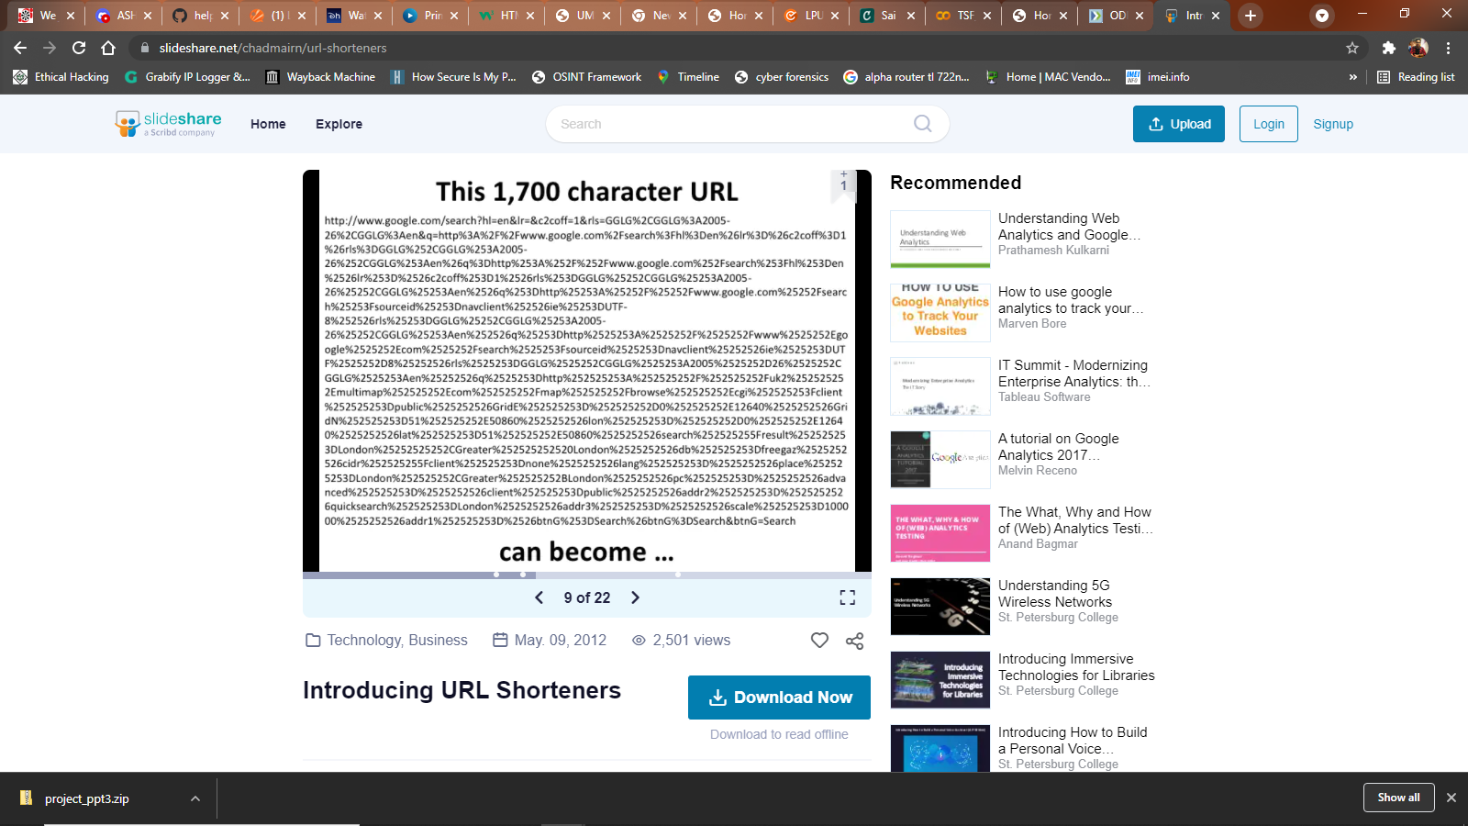
WHY DO WE NEED SHORTENER URL ?
If you URL is like this
https://www.w3schools.com/html/html_images.asp
Then we actually no need of Shortener URL as some can memorise
BUT WHAT IF YOUR URL IS
Chitti – The Robot will be the only person to remember this 1700 character URL

Slide 6
ABOUT
URL Stands for Uniform Resource Locator and it essentially links to resources on the web.
URL consists of Hypertext Transfer Protocol followed by the domain name.
In this Project, our URL will be the Localhost i.e. 127.0.0.1:5000 where 5000 is port number.
URL Shortener is used to make a long URL into a small URL so that whenever we access the shortener URL it should redirect to the original URL.

Slide 7



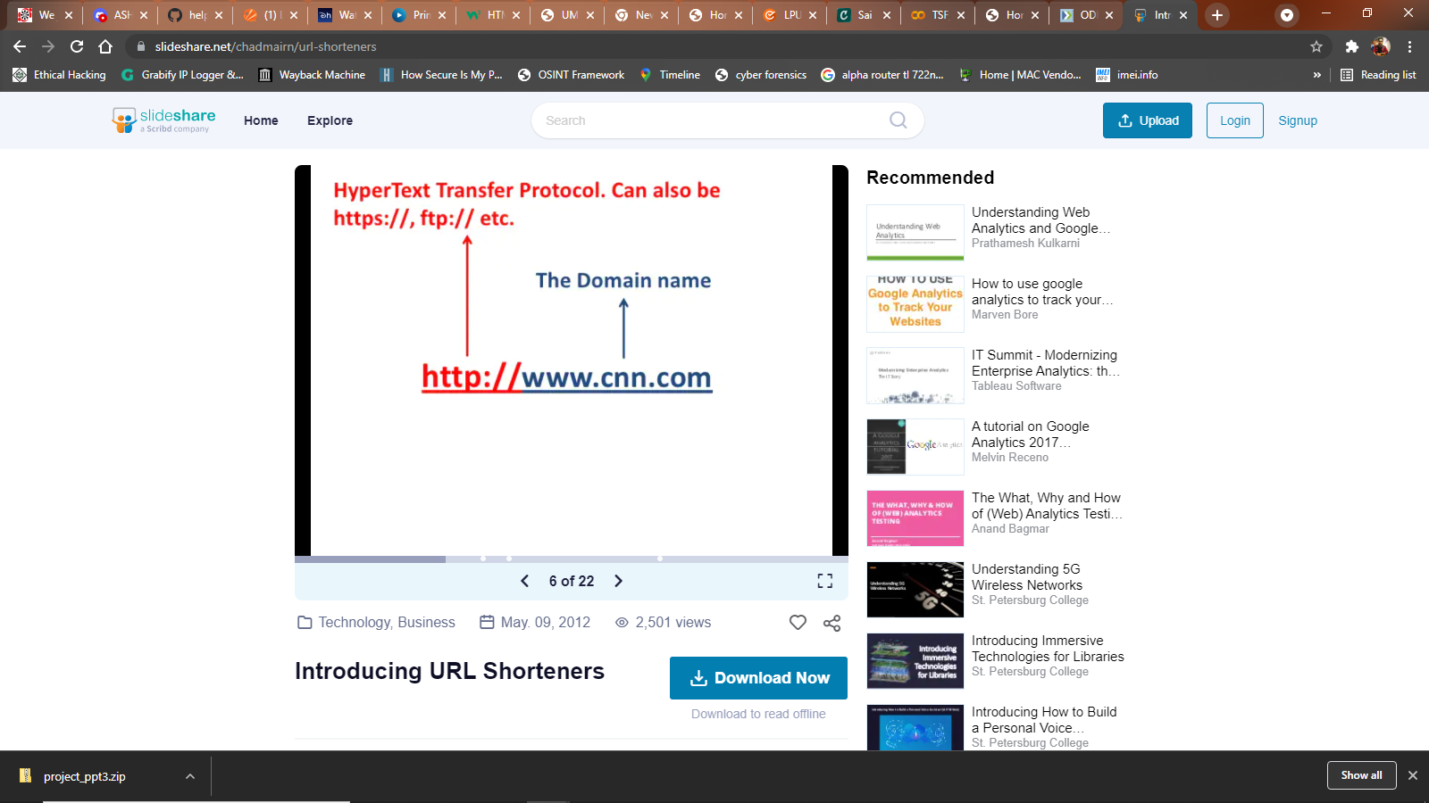

*THIS IS HOW
I LOOK LIKE
URL

Slide 8





WEB APPLICATION
USER
FRONTEND
BACKEND
TEMPLATES
REQUEST
RESPONSE
WEB PAGE
APPLICATION SERVER
DATABASE

Slide 9

PROJECT
Backend
Frontend

Slide 10

BACKEND
(APPLICATION SERVER)
App.py

Slide 11

Backend – Application Server
This Project is built using Flask. “app.py” is the Application Server where we imported
required libraries
import os
from flask import Flask, render_template, request, redirect
from flask_sqlalchemy import SQLAlchemy
from flask_migrate import Migrate
import string
import random

Slide 12
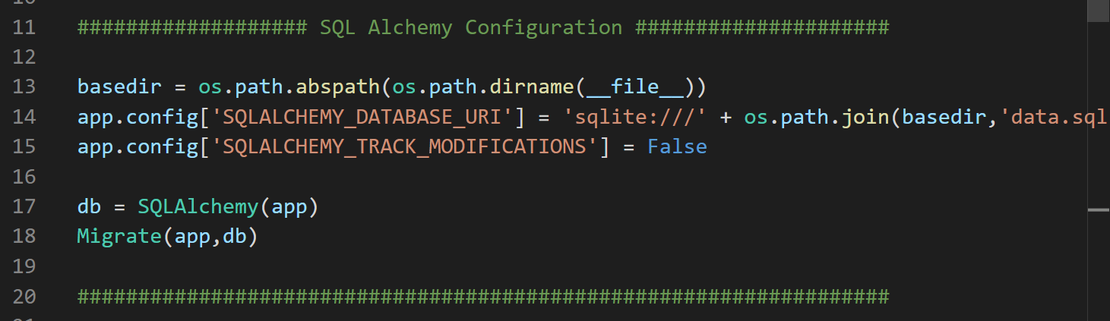
“SQL Alchemy Configuration”
After Importing libraries, the next step is “SQL Alchemy Configuration”

Slide 13
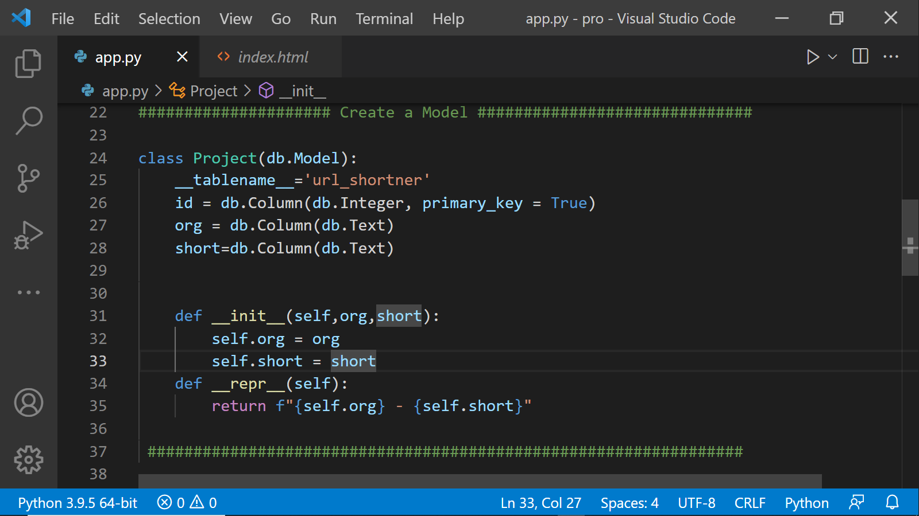
“Create a Model”
The next step is to Create a Model using Class and def which helps to create a table name and column names

Slide 14
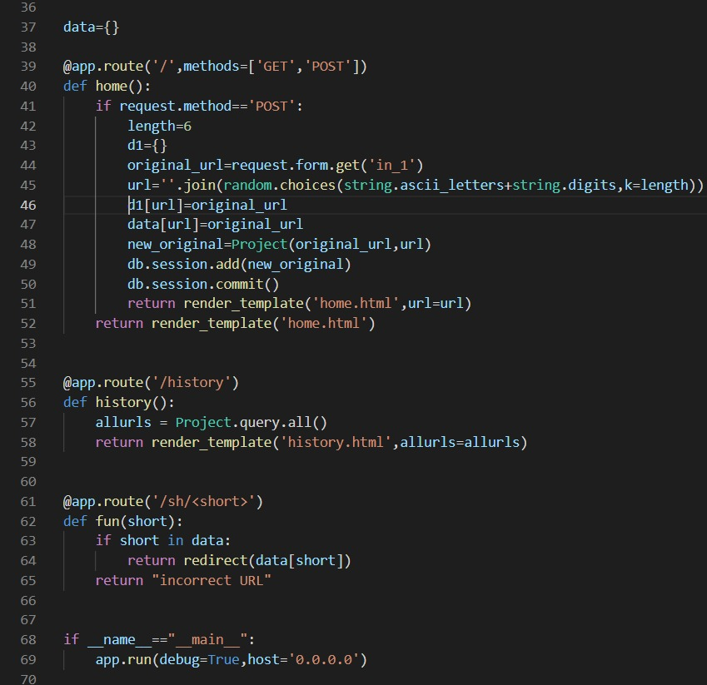
“Creating Routes ”
Then comes the Flask part to create the required routes with functions binded which helps in connecting the frontend (i.e. to HTML Pages)

Slide 15

FRONTEND
(HTML PAGES)
Layout.html
Index.html
History.html

Slide 16
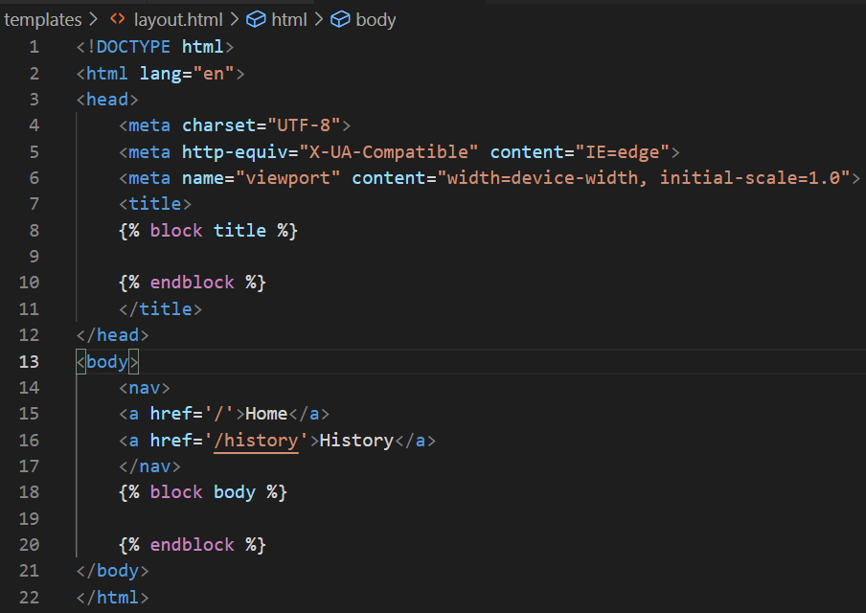
“Layout.html”
The Inheritance Page which gives the same layout to all the html pages and save time to create header footer again and again for every html file

Slide 17
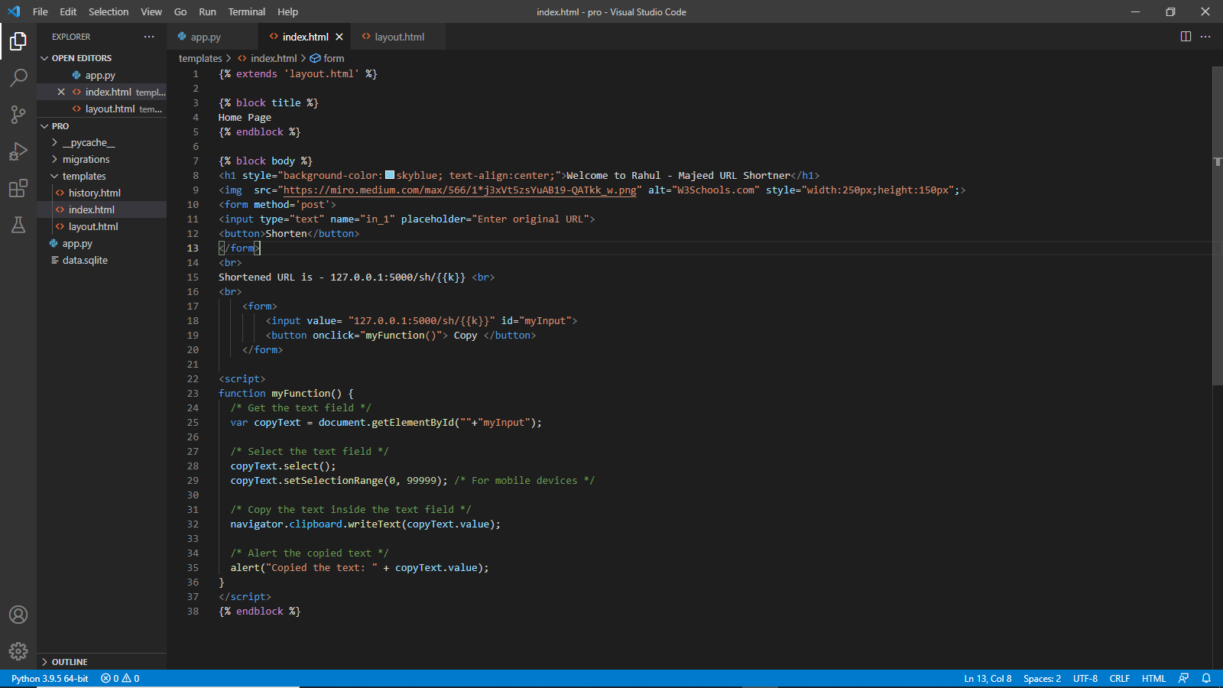
“Index.html”
The Index Page where the original URL should be entered, and the shortened URL will be displayed with a copy button so that user can easily copy the URL to Clipboard and able to use in the browser. Here JS is used for Copy Button

Slide 18
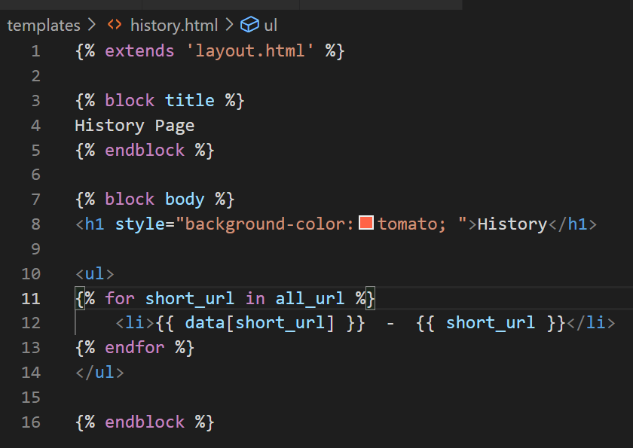
“History.html”
The Page displays the History of the URL’s and the respective Shortened URL’s

Slide 19

ORIGINAL – SHORTENER WHICH IS KEY AND VALUE ?

Slide 20

OUTPUT
Index.html page
History.html page

Slide 21
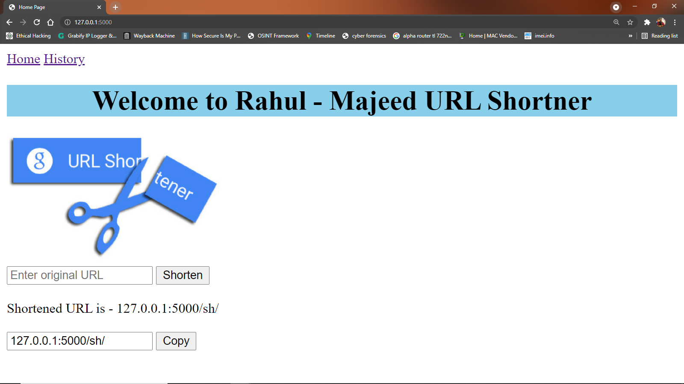
Index.html → Home Page

Slide 22
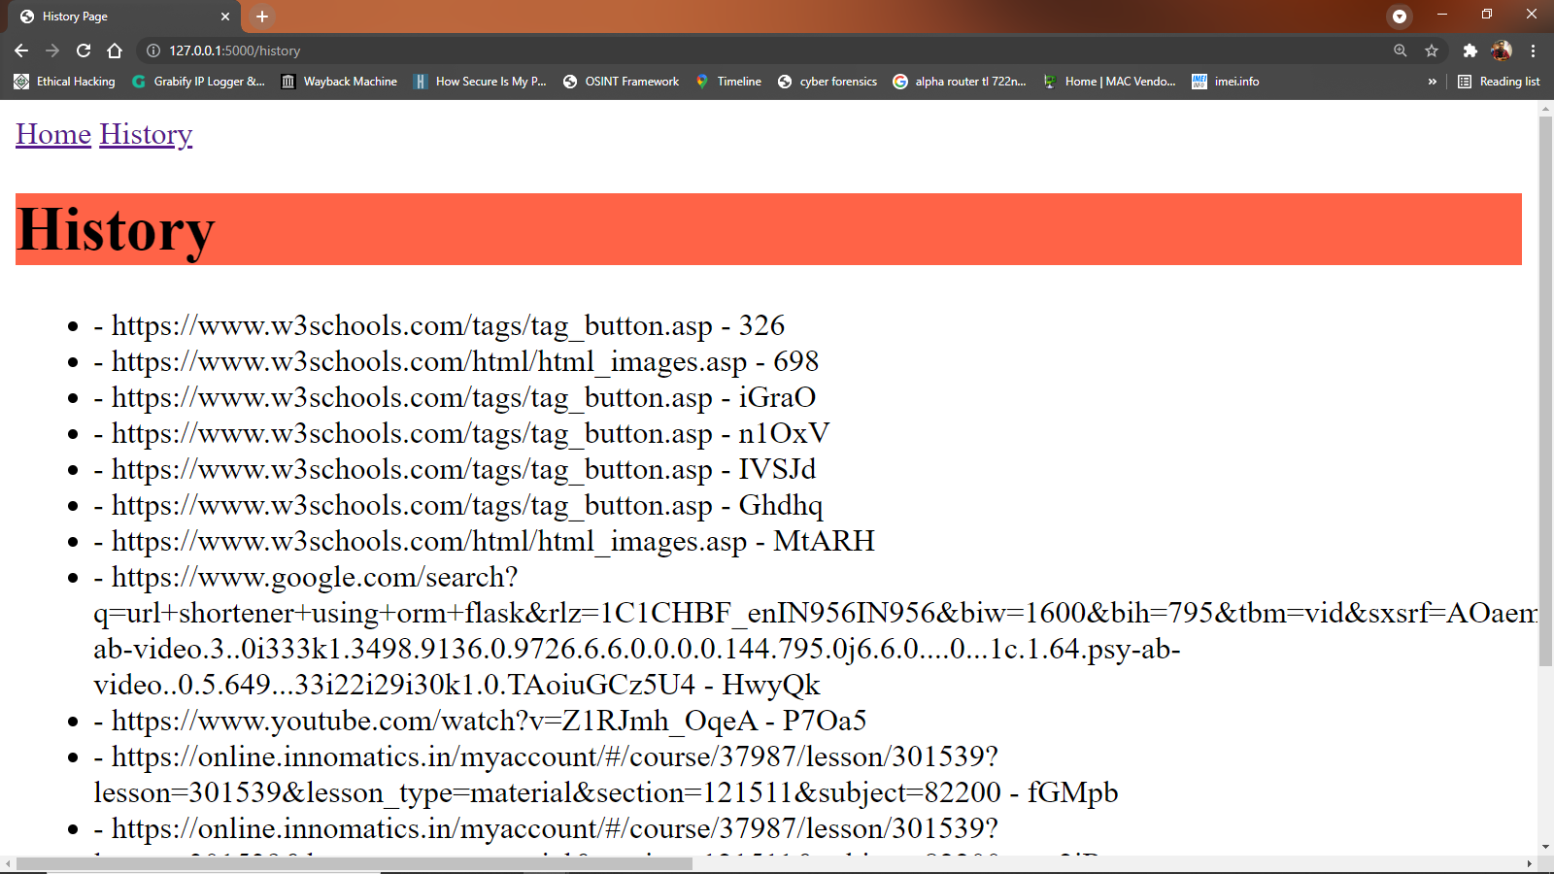
History.html → History Page

Slide 23

THANK YOU

